Slide 1
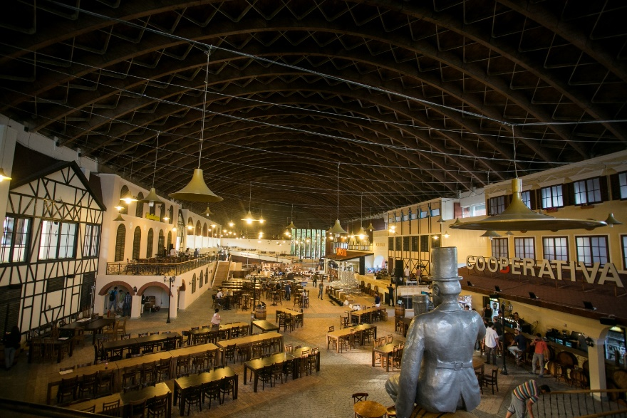

Sign up
First Name
Last Name
Email
Phone
Password
Confirm Password
Sign up
Log in

Slide 2
Welcome to Berăria H
Email
Password
Remember Password
Log In
Sign up
Forgot your password

Slide 3


Home
Events
My Bookings
Gallery
Feedback
Contact
My Profile

Slide 4


Events
Picture
Mihai Margineanu & Band in concert
Tuesday, 29 September
Hour: 20:00
More details
Picture
Queen Tribute Concert – The Story of a Legend
Wednesday, 29 July
Hour: 20:00
More details
Picture
Monica Anghel & Andrei Tudor Band
Thursday, 29 March
Hour: 20:00
More details

Slide 5
Event Details
Mihai Margineanu & Band in concert
Description: Pe 23 martie trupa MerQury Legacy (Italia) revine la Bucureşti pentru încă un concert memorabil Queen Tribute. Nu rata povestea unei legende spusă#live pe scena Oraşului cu Chef de Viaţă de posibil cel mai bun band tribut Queen & Freddie Mercury al Europei.
Hour: 20:00 ,Tuesday, 29 September
Tip Eveniment: Music
Back
Add Booking

Slide 6
Add Booking
Name (Text)
Phone (Number)
Email (Text)
Categoria (DropDown : A, B sau C)
Number of Seats
Children (number)
Arrival Time (hour:minute)
Comments (text)
Back
Book now

